Slide 1
Collection Framework Vector Class
momedaram

Slide 2
A vector stores elements (objects) similar to ArrayList, but vector is synchronized.
The underlying data structure is growable array.
Allows duplicate objects.
Insertion order preserved.
Allows Heterogeneous objects
Null insertion is possible

Slide 3
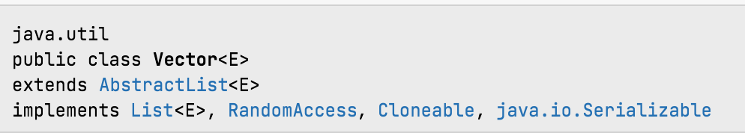
Vector class internally implements Serializable and Cloneable interfaces.
Vector class implements RandomAccess interface so that any random element we can access with the same speed.
Every method present in Vector is synchronized and hence Vector is Thread safe.

Slide 4
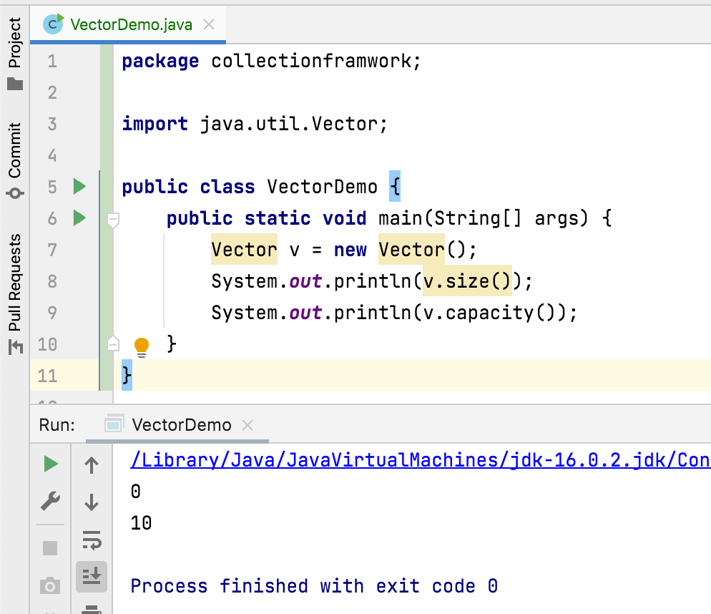
Vector Constructors
Constructors of Vector class, provides many ways to create the Vector objects.
1. Vector v = new Vector();
Constructs an empty vector so that its internal data array has size 10.

Slide 5

















Once the Vector object reaches it max capacity , a new vector Object will be created with new capacity of (Current Capacity * 2) and objects will be shifted to newly created vector object and so on.
A B C D E F G H I J
v
A
B
C
D
E
F
G
H
I
J
K

Slide 6
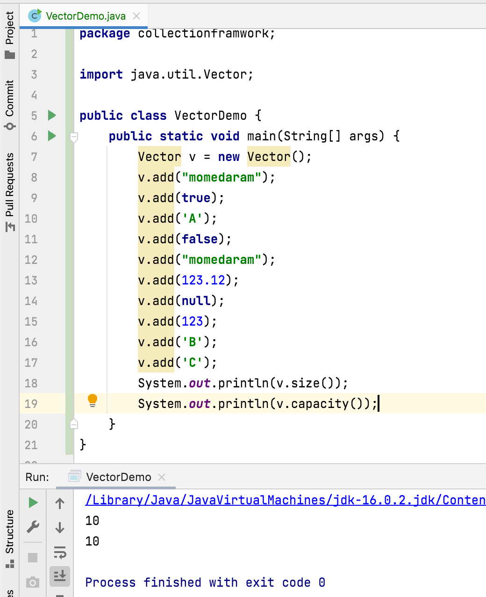
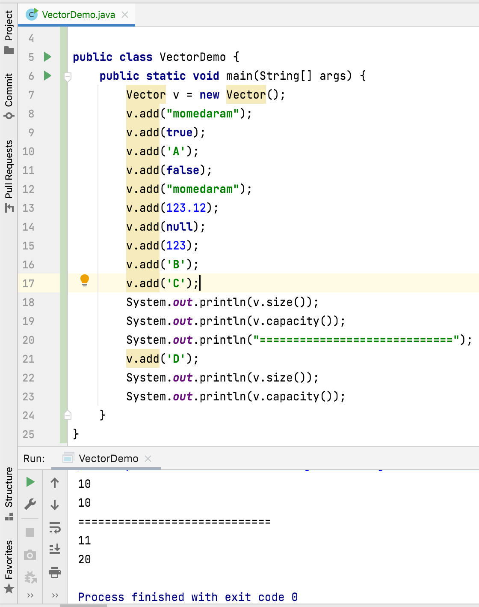

Slide 7
2. Vector v = new Vector(int initialCapacity);
Constructs an empty vector with the specified initial capacity.
3. Vector v = new Vector(int initialCapacity, int capacityIncrement);
Constructs an empty vector with the specified initial capacity and capacity increment.
4. Vector v = new Vector(Collection<? extends E> c)
Constructs a vector containing the elements of the specified collection.

Slide 8
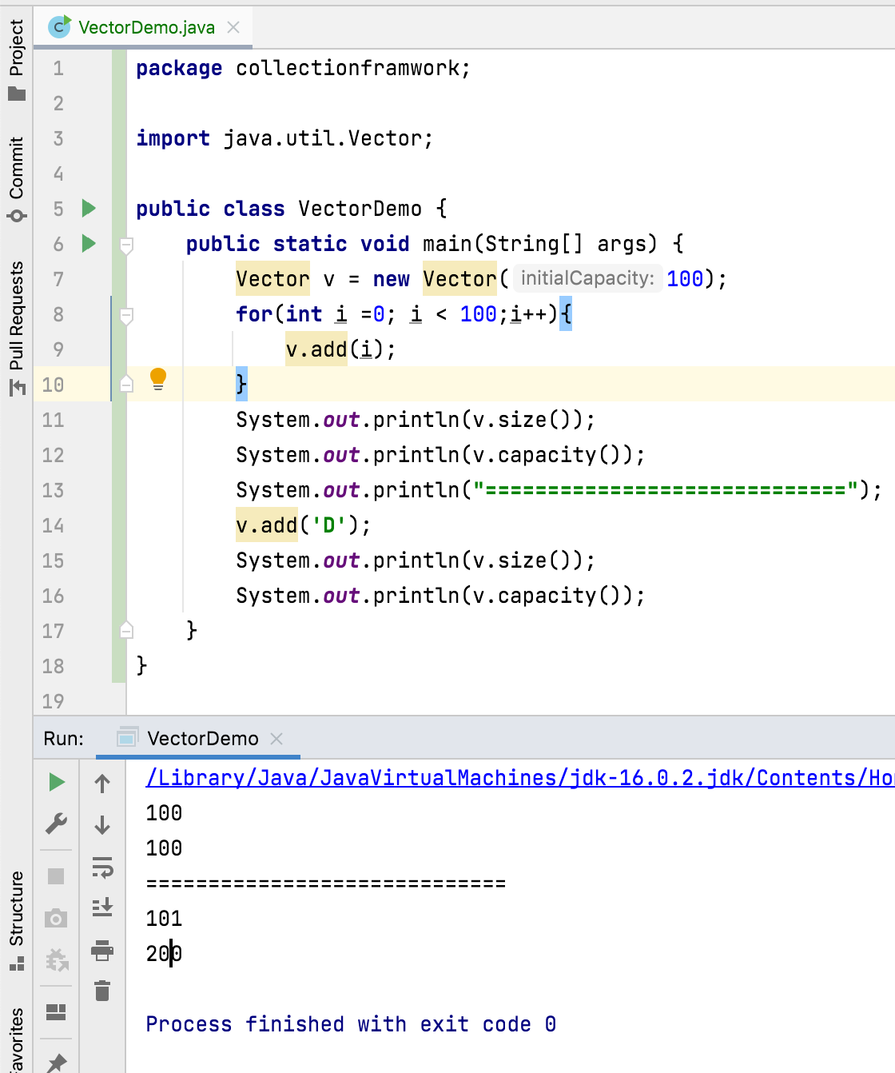
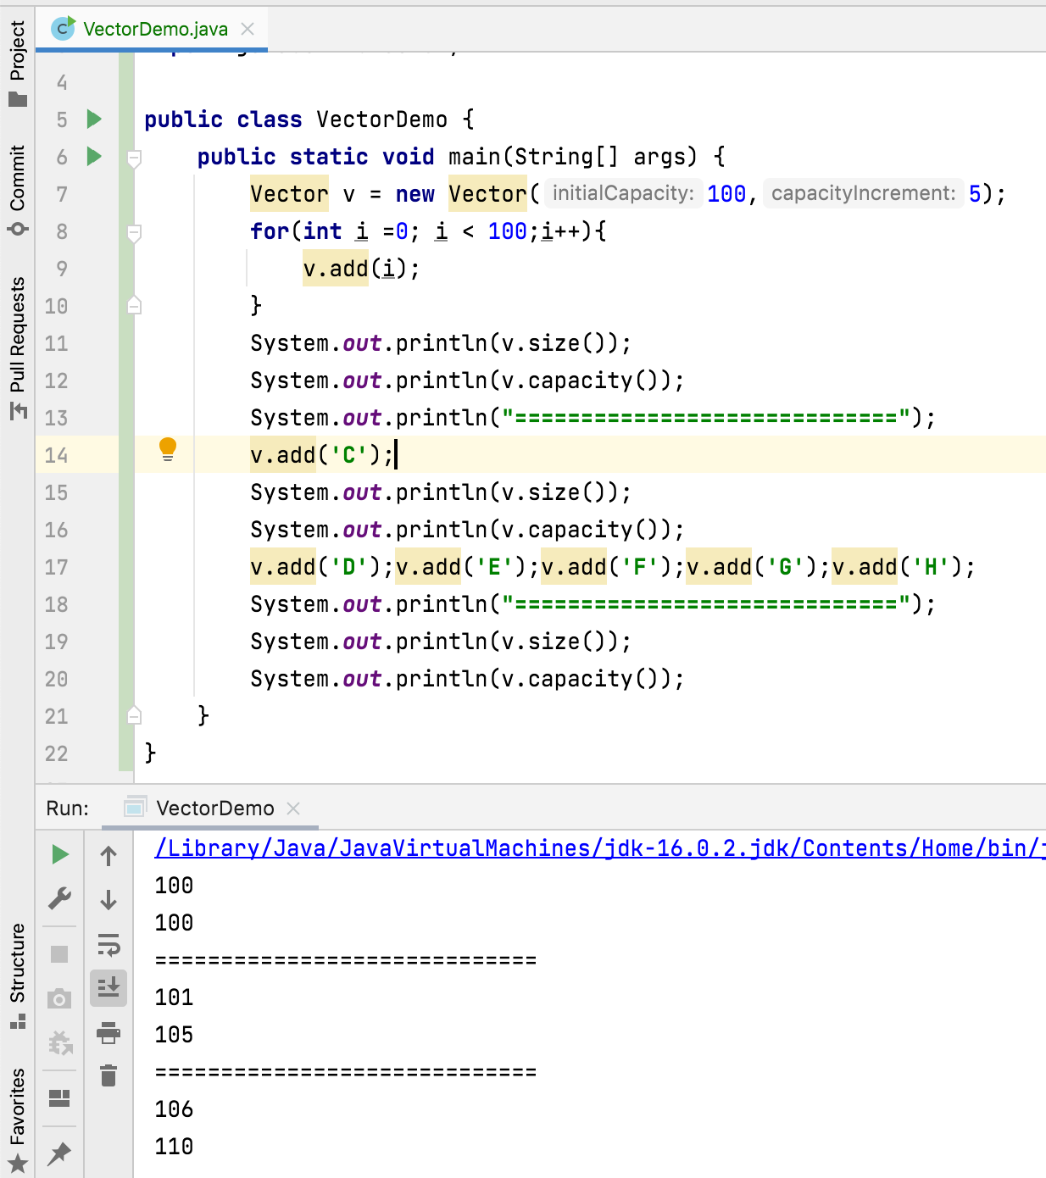

Slide 9
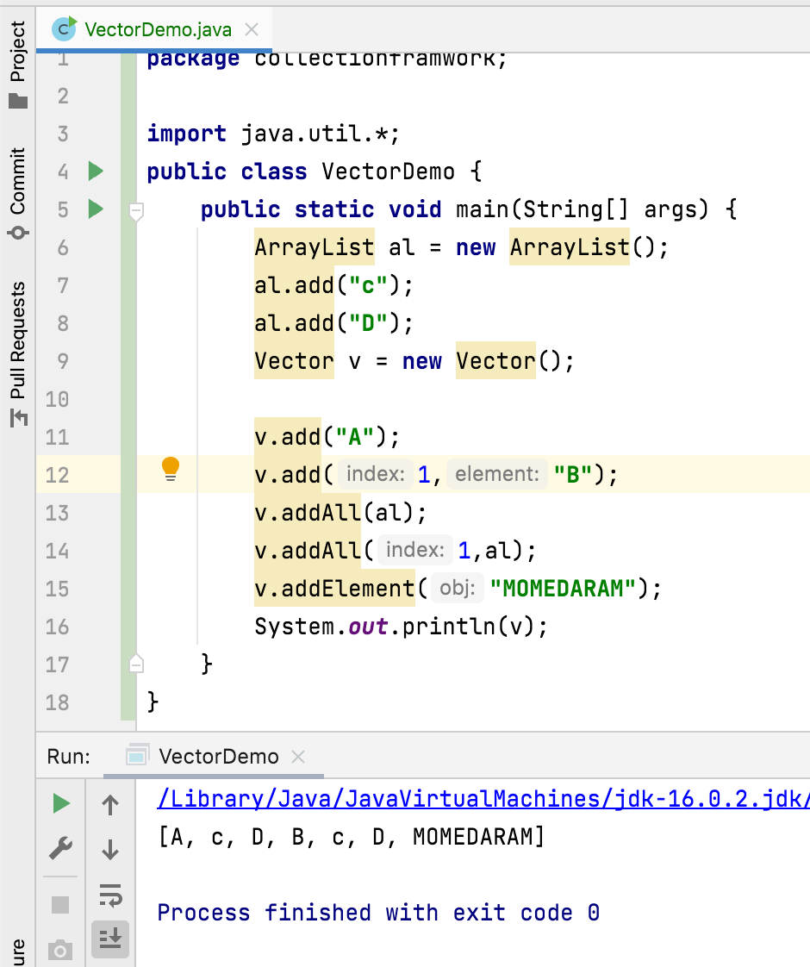
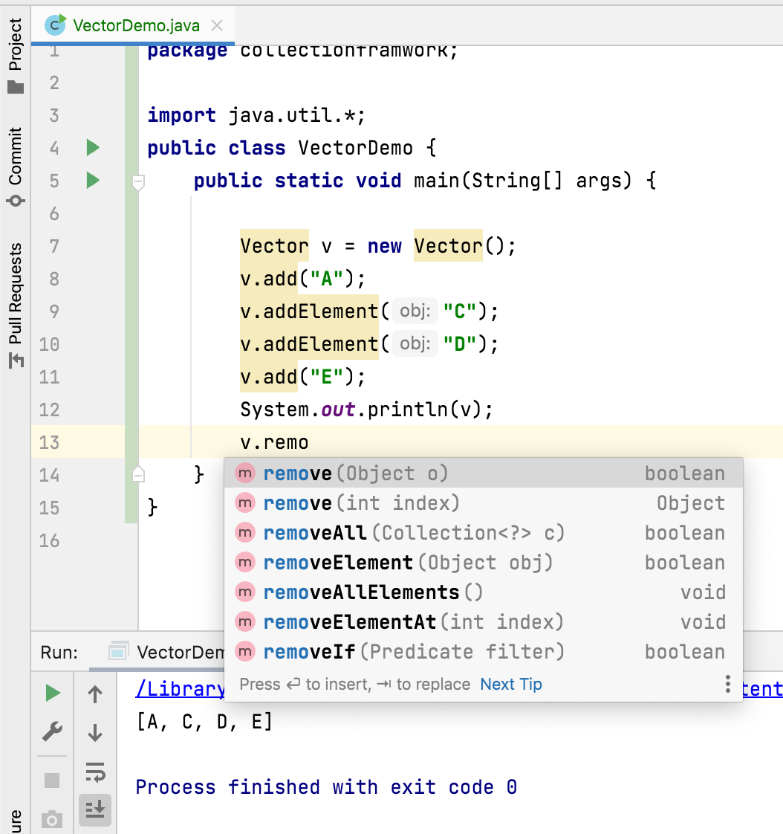

Slide 10
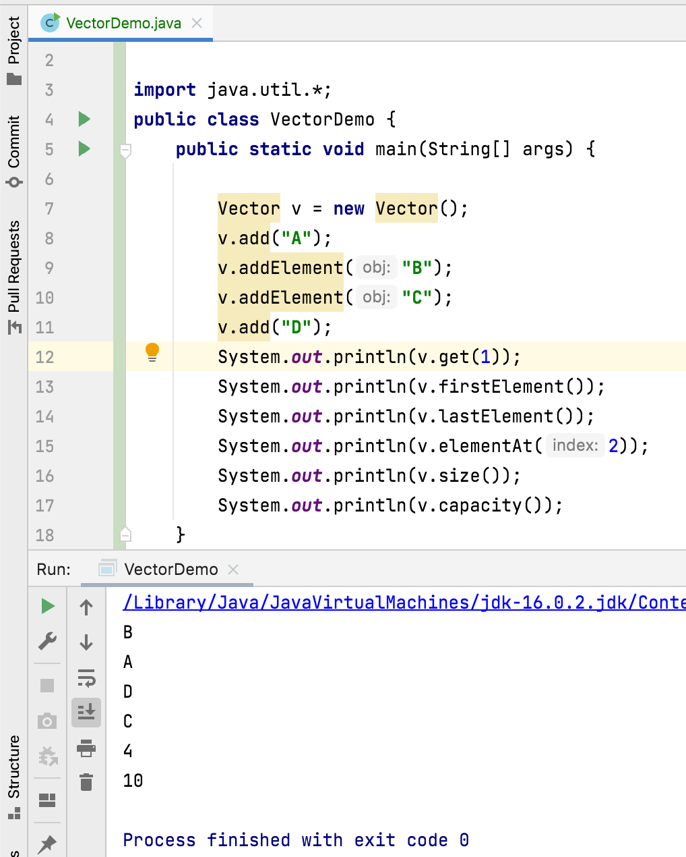

Slide 11
Thank You !
momedaram

